Slide 1
Prithvi EO- Generalist Geospatial Foundation Model
Dr. Sujit Roy Lead AI Researcher NASA IMPACT

Slide 2
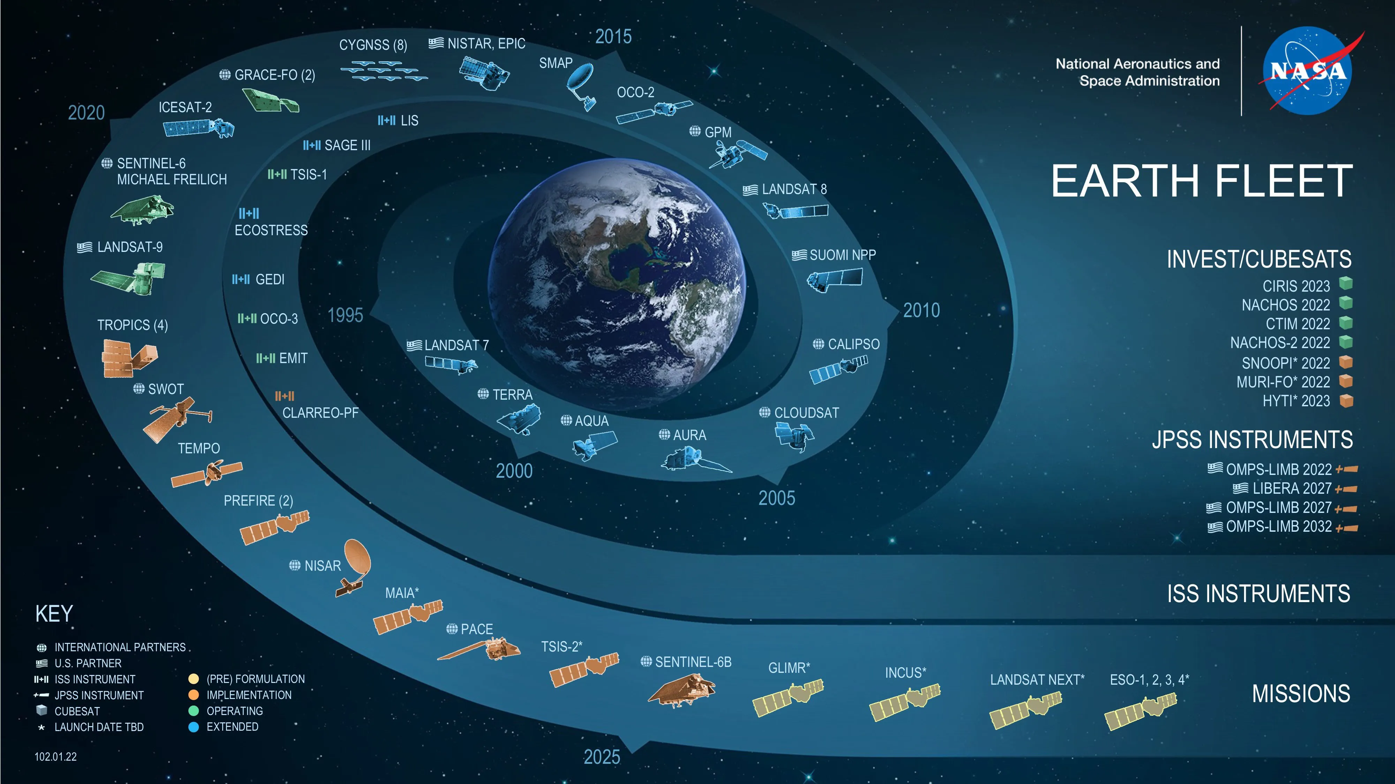
Collected hundreds of petabytes of data
Challenging to explore and process the massive unlabeled data
1 PB = 1,000,000,000,000,000 bytes
Notes:
Drowning in sea of data yet starving for know-ledge 🤔

Slide 3
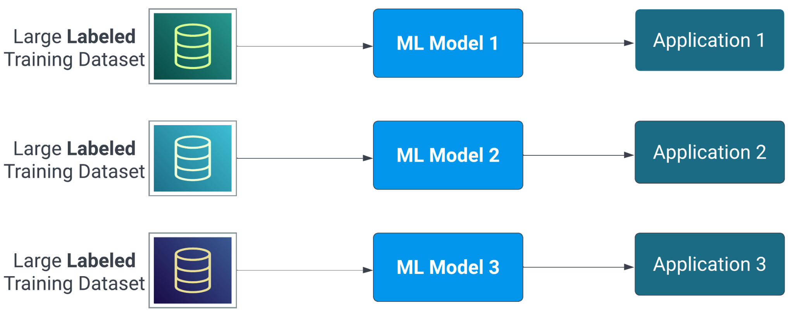
AI-Traditional Supervised Learning Approach

Slide 4
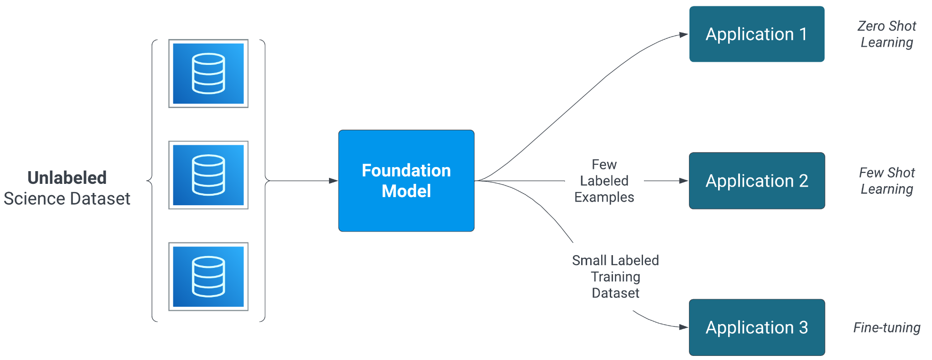
AI - Foundation Model Approach
Notes:
An AI Foundation Model is a large machine learning model pre-trained on a vast amount of data using self-supervision, enabling it to perform a wide range of tasks.

Slide 5
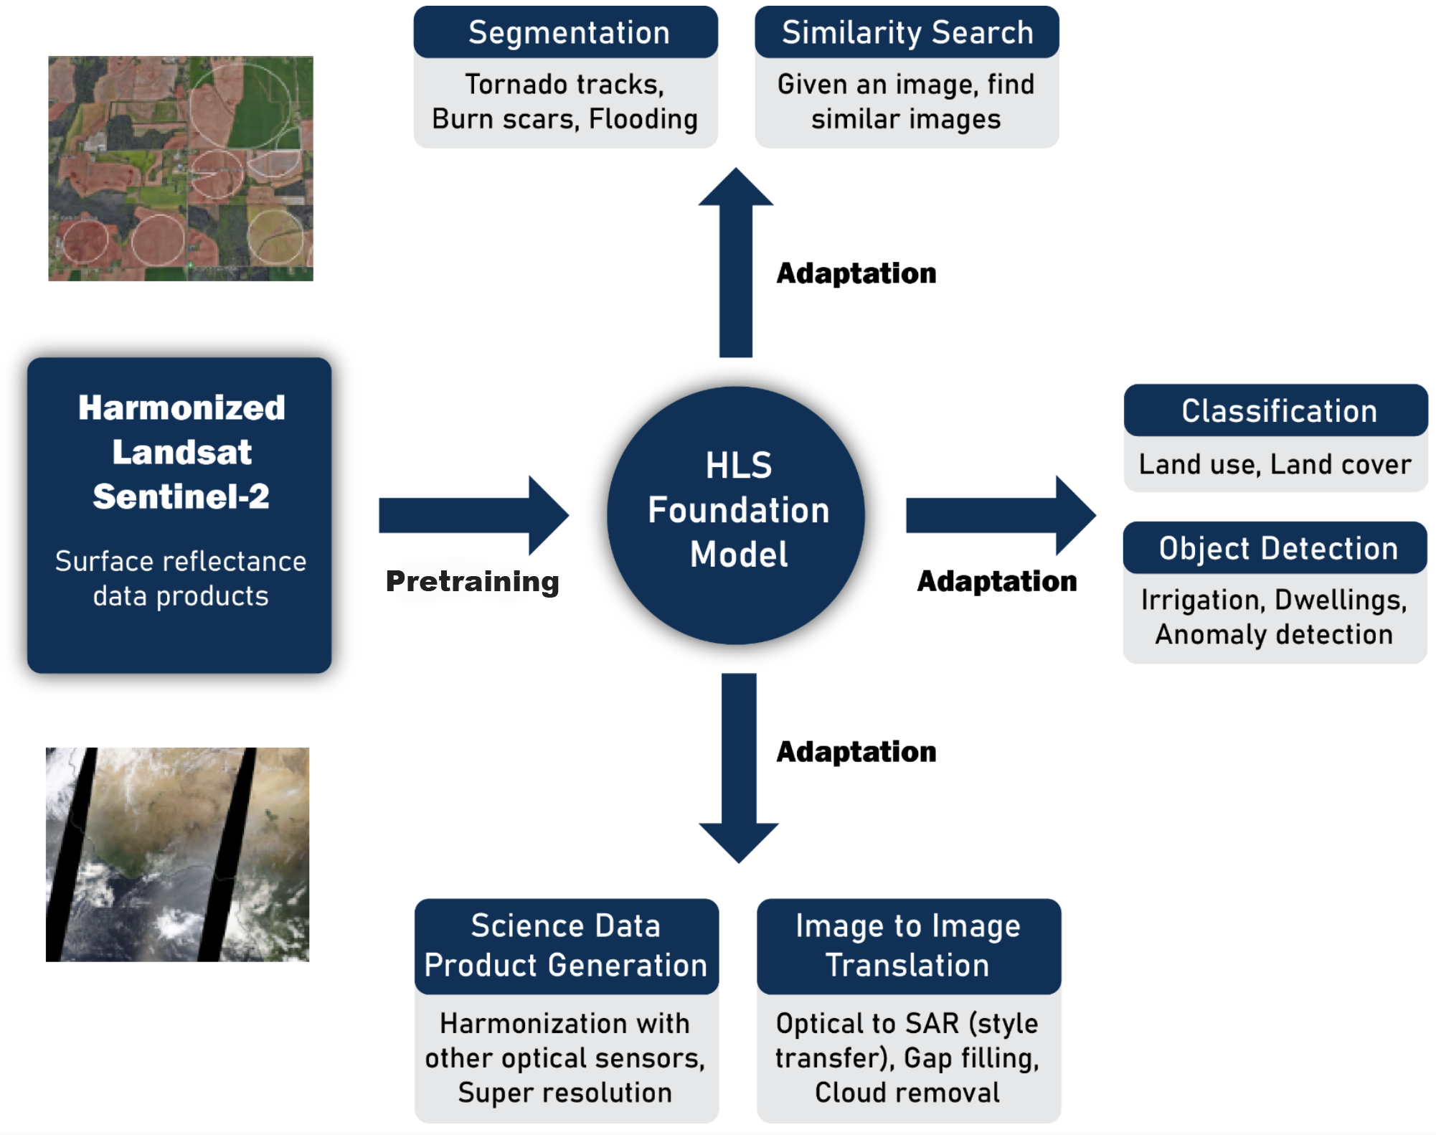
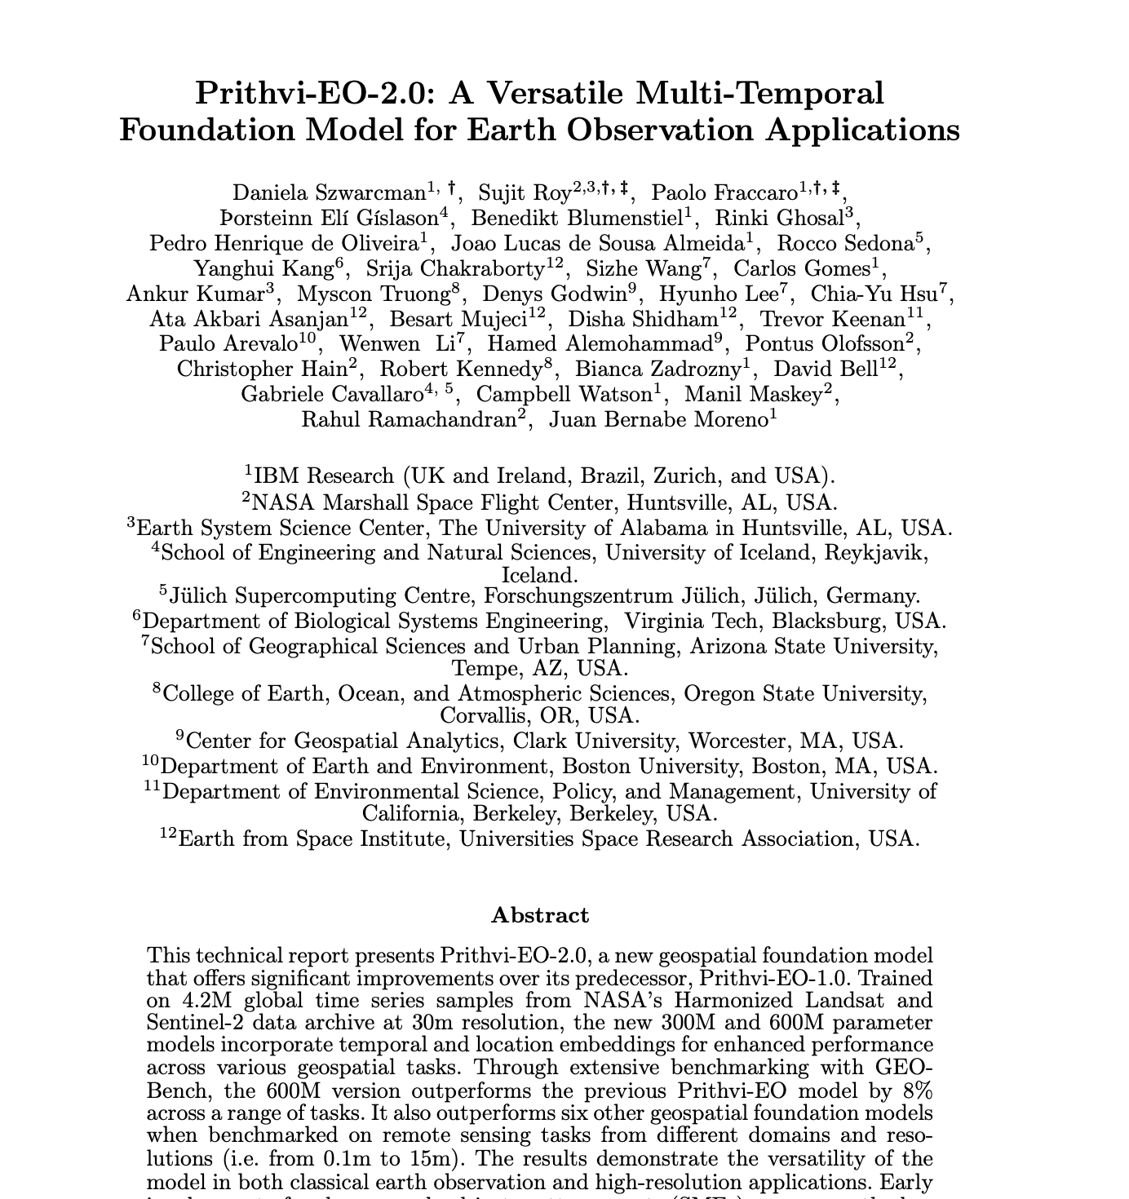
Prithvi: Generalist Geospatial FM
Built with collaboration with IBM Research
Initial released (2023) are 100M parameter model pretrained on HLS CONUS data
Evaluated for adaptation for different categories of downstream tasks
Collaborations: IBM, UAH, Clark University, ORNL, Hugging Face https://arxiv.org/pdf/2310.18660.pdf https://arxiv.org/pdf/2412.02732
Notes:
Masked AutoEncoder (MAE) where attention mechanism is extended in space and time

Slide 6
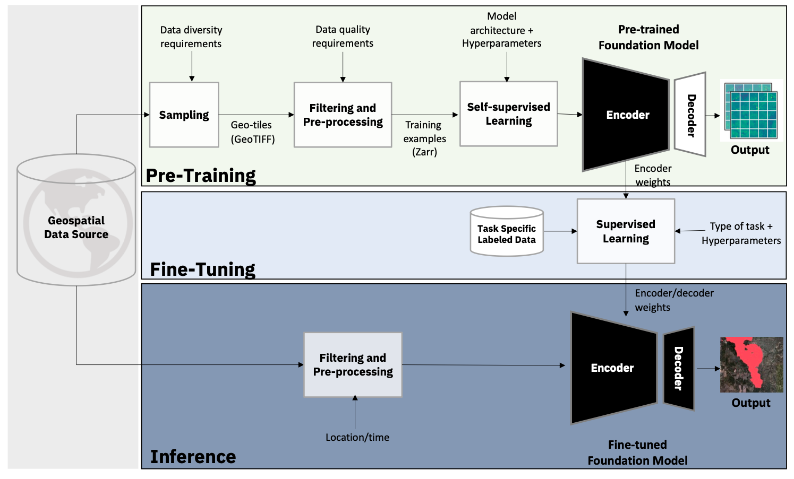

Slide 7
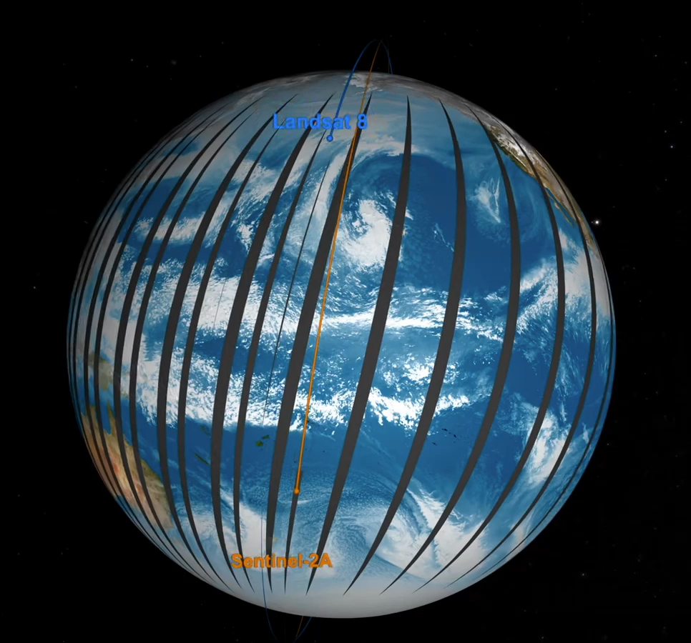
Harmonized Earth surface reflectance data products from Landsat 8/9, Sentinel-2A/2B
Total 15 vis & thermal infrared bands
Global land coverage
2-3 days observations
High spatial resolution: 30m/pixel
Two data products: L30, S30
File format: GeoTIFF
Tile size: 3660 x 3660 in pixels (110 km x 110 km)
Temporal coverage from 2013.4
Notes:
https://hls.gsfc.nasa.gov/
Landsat-8: 705 km altitude, 16 day repeat cycle (swath width 185 km)
Sentinel-2, 786 km altitude, with 5 day repeat cycle (20.6 degree field of view (swath width 290 km), spatial resolution from 10 meter to 60 meters with spectral bands.
Titling system: MGRS 100km x 100km (military grid reference system)
3660 pixels x 30 meter/pixel = 109.8 km
Why exact Antarctica?

Slide 8
HLS Data Preparation/Sampling for Pretraining
Goal: high quality dataset for robust model training and validation
Minimum cloud & NaN issues
Cloud coverage < 15%
NaN per tile < 5%
Represent diverse land use and diverse ecosystems
Sampling from each LULC class separately to ensure the presence of each class
LULC entropy is used as proxy to further add diverse landscape (~ 800 ecoregion)
Notes:
Diversified pre-training dataset
For a given region, images can be similar across time (???)
Random sampling can be bias towards most of common landscapes
Sampling scheme based on geospatial statiscs
Aggregate various geospatial statistics (temperature and precipitation)
Divide region into groups based on these statistics
Sample HLS tiles as equally as possible from each group (number or percentage?)

Slide 9
3028 train tiles visualized in green to red. 163 validation tiles visualized in blue (up to 392 samples per tile).
35 sampled train tiles and 2 validation tiles have no samples because of insufficient data coverage or cloud-free areas (e.g. Antarctica).
96 tiles in the far north have been dropped due to quality issues.

Slide 10
Temporal Distribution
Train samples
Validation samples

Slide 11
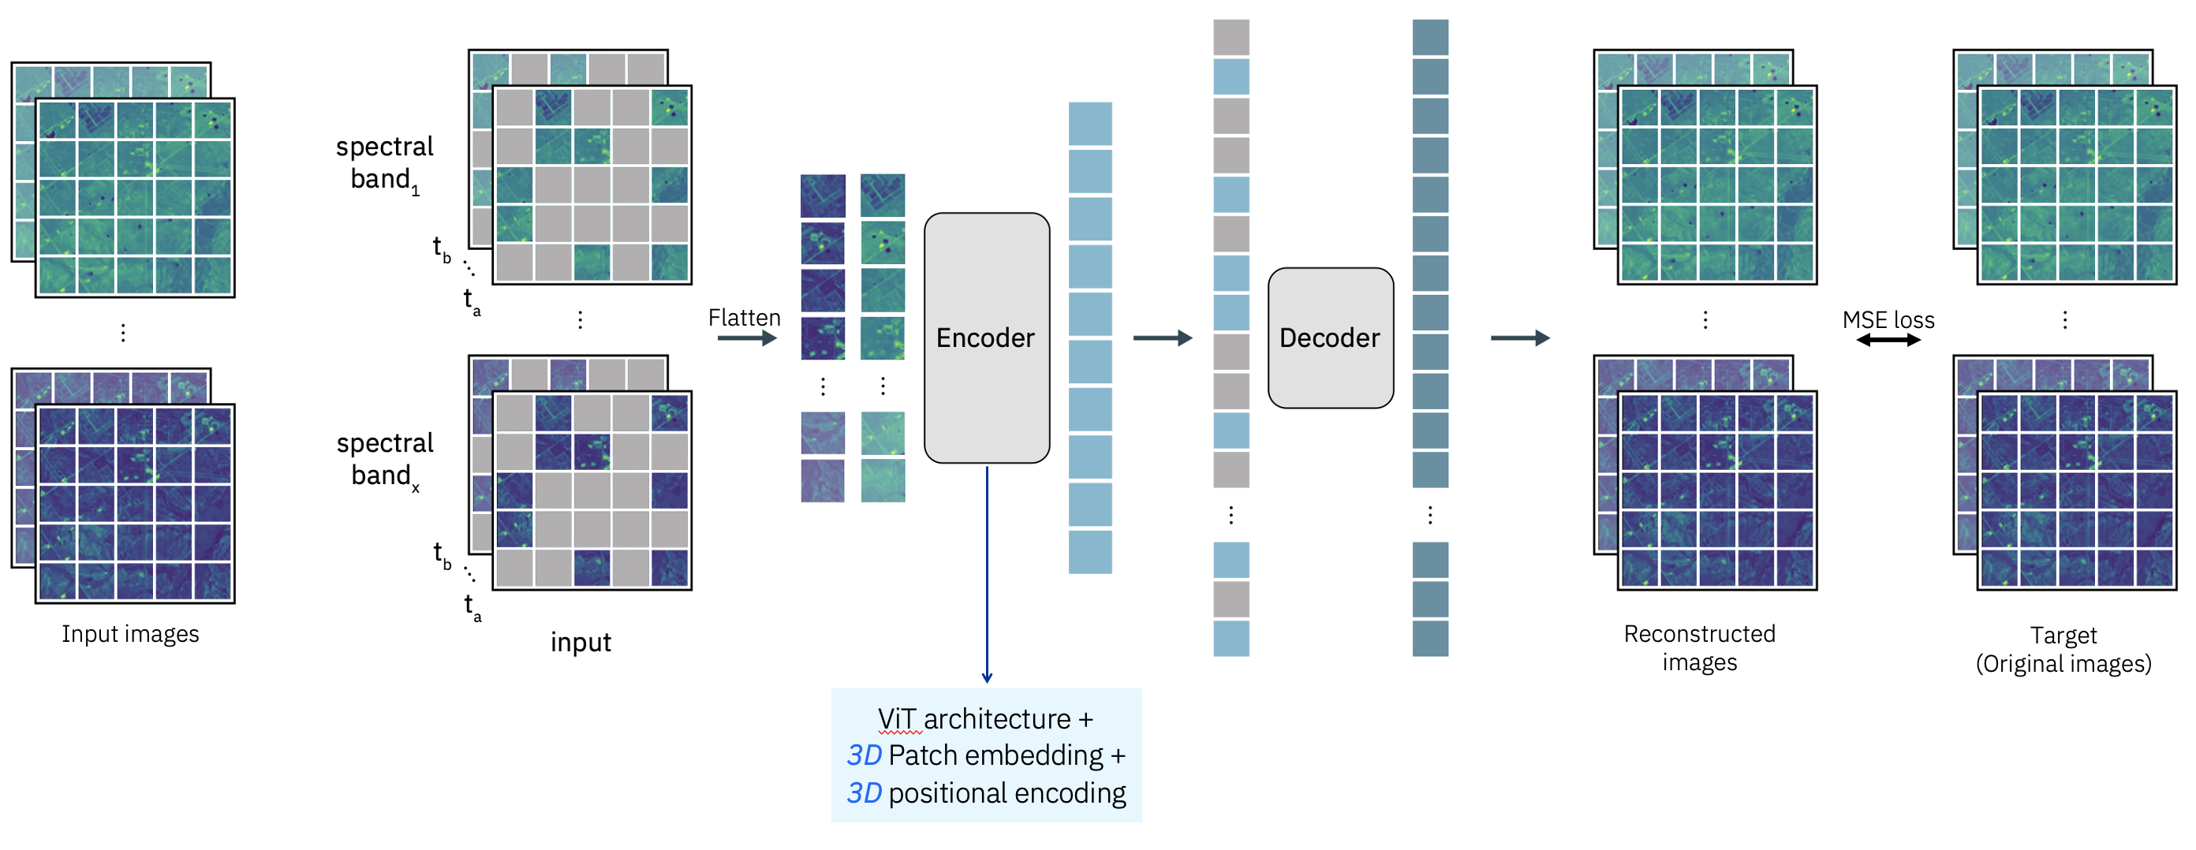
Prithvi Training Architecture –Masked AutoEncoder(MAE)
Notes:
We used the ViT- L style encoder decoder, with 75% masking of Information. During pretraining, the task for the model was to generate 75% of the information by learning data representation from 25% of information available. We also added location and temporal embedding, but trained with dropouts. This helped in finetuning the models even if the temporal and location information is not present. The model includes spatial attention across multiple patches and also temporal attention for each patch.

Slide 12
Prithvi Pretraining
Data
3000+ tiles covering about 60% of all urban regions globally 2015 - 2023
4.2 million samples for training (sample size: 224 x 224 x 6 x 3)
45,568 samples for validation
Training
A100 GPU with 40 GB memory, 4 GPUs per node
Pretraining: 80 GPUs (20 nodes), ran for about 11 days
The pretrained models with 300M and 600M parameters are available on 🤗
https://huggingface.co/datasets/ibm-nasa-geospatial

Slide 13
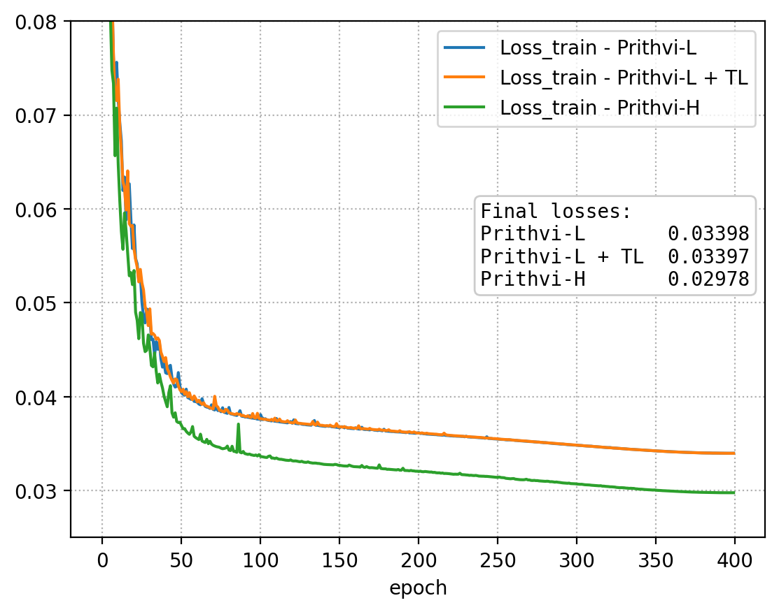
Training Time & Compute
Model | Time | Nvidia A100
Prithvi-L | ~11 days | 80 GPUs
Prithvi-H | ~10 days | 240 GPUs

Slide 14
Downstream Applications
Segmentation
Burn scar detection
Flood water delineation
Landslide
Crop classification
Burn intensity
Regression: GPP flux / eddy covariance
Generative: Cloud gap imputation

Slide 15
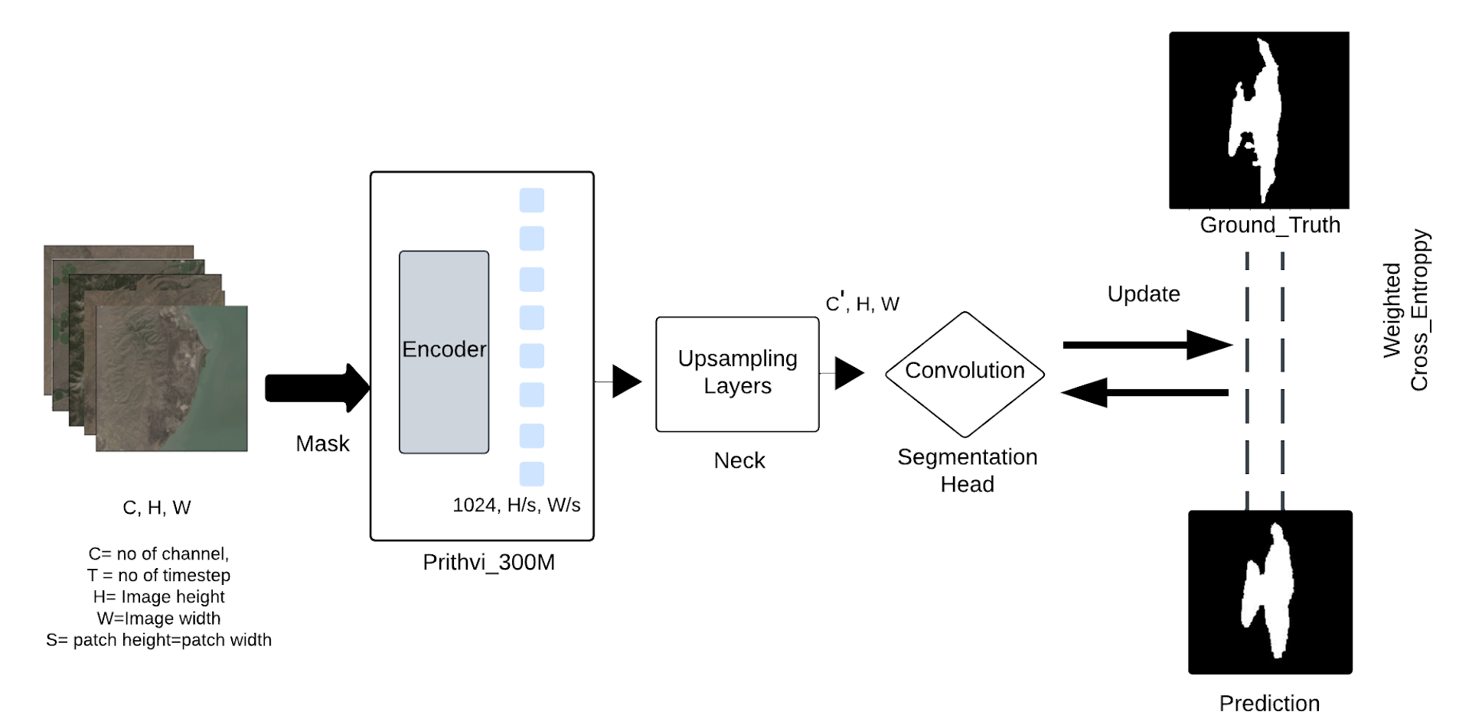
Prithvi Finetuning for Burn Scar, Flood Mapping
Data: Single timestep HLS images (30m), with binary class labels
Notes:
Training data: 446 labeled 512 x 512 chips covering 14 biomes, 357 ecoregions, 6 continents of the world across 11 flood events (token /patch size: 16x16?)
6 bands: blue, green, red, narrow NIR, swIR1 SWIR2
Labels: 0 - no water; 1 - water/flood; -1 - no data/cloud

Slide 16
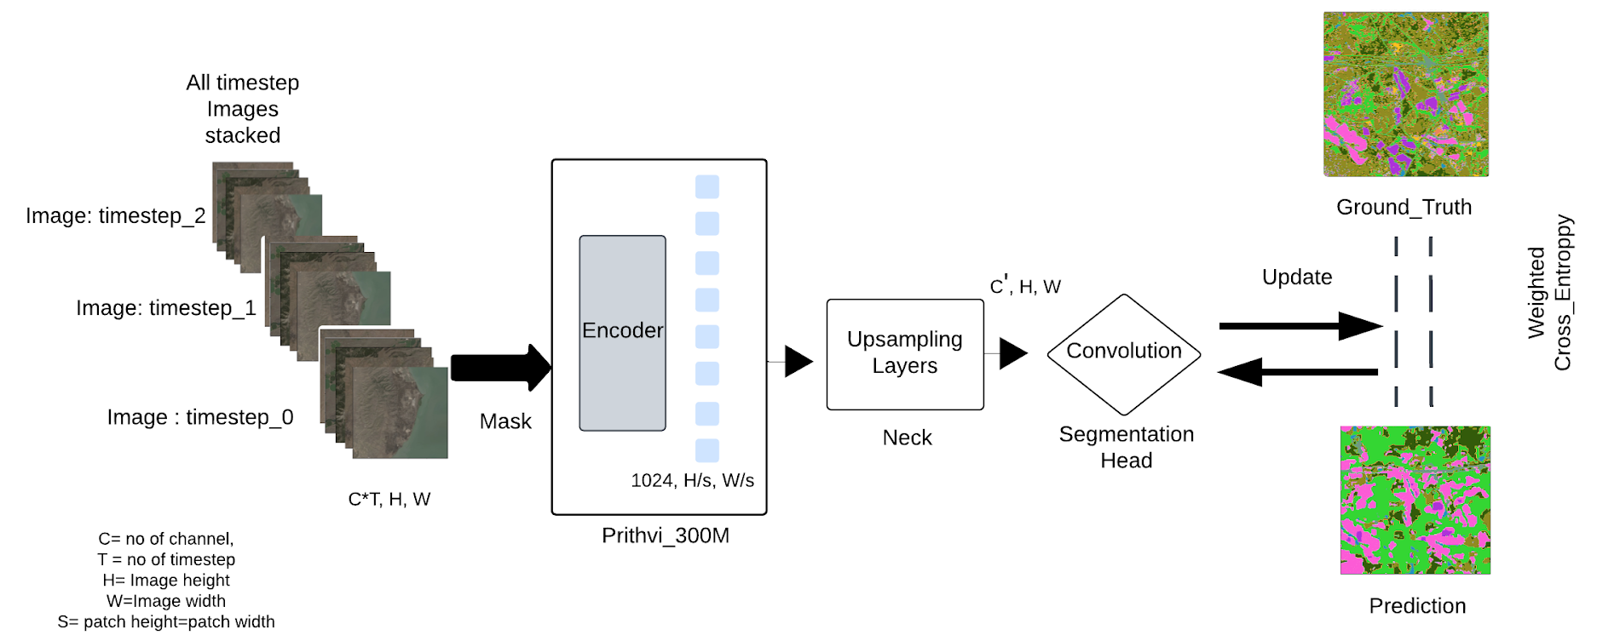
Prithvi Finetuning for Crop Classification, Burn Intensity
Data: 3-timesteps HLS images (30m), with multi-class labels

Slide 17
Prithvi EO 2.0 – Data and Model Scaling Matters
GEO-Bench¹ classification tasks
GEO-Bench¹ segmentation tasks
+3%
+2%
+2%
1 Lacoste, A., Lehmann, N., Rodriguez, P., Sherwin, E., Kerner, H., Lütjens, B., ... & Zhu, X. (2024). Geo-bench: Toward foundation models for earth monitoring. Advances in Neural Information Processing Systems, 36.

Slide 18
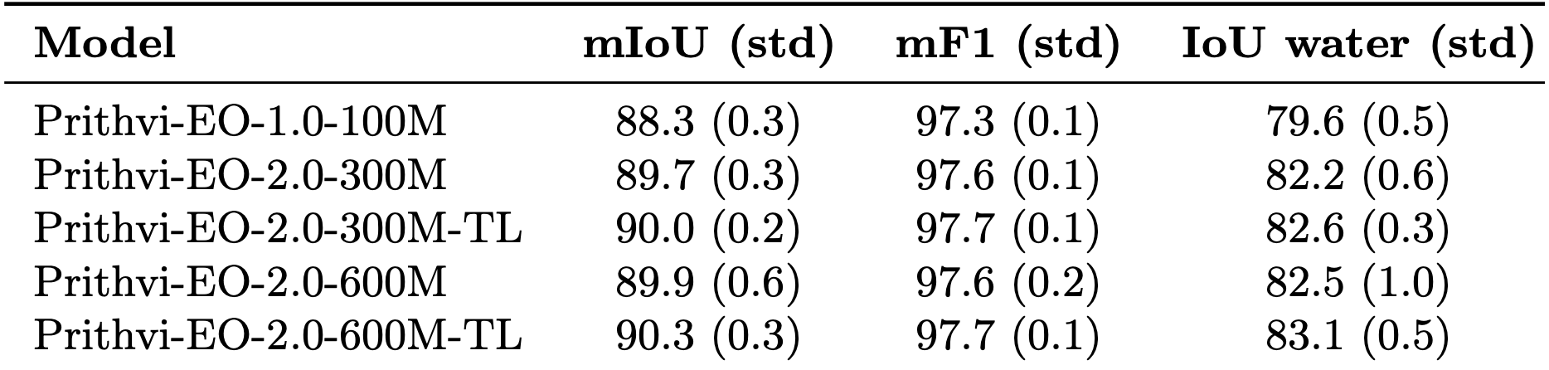
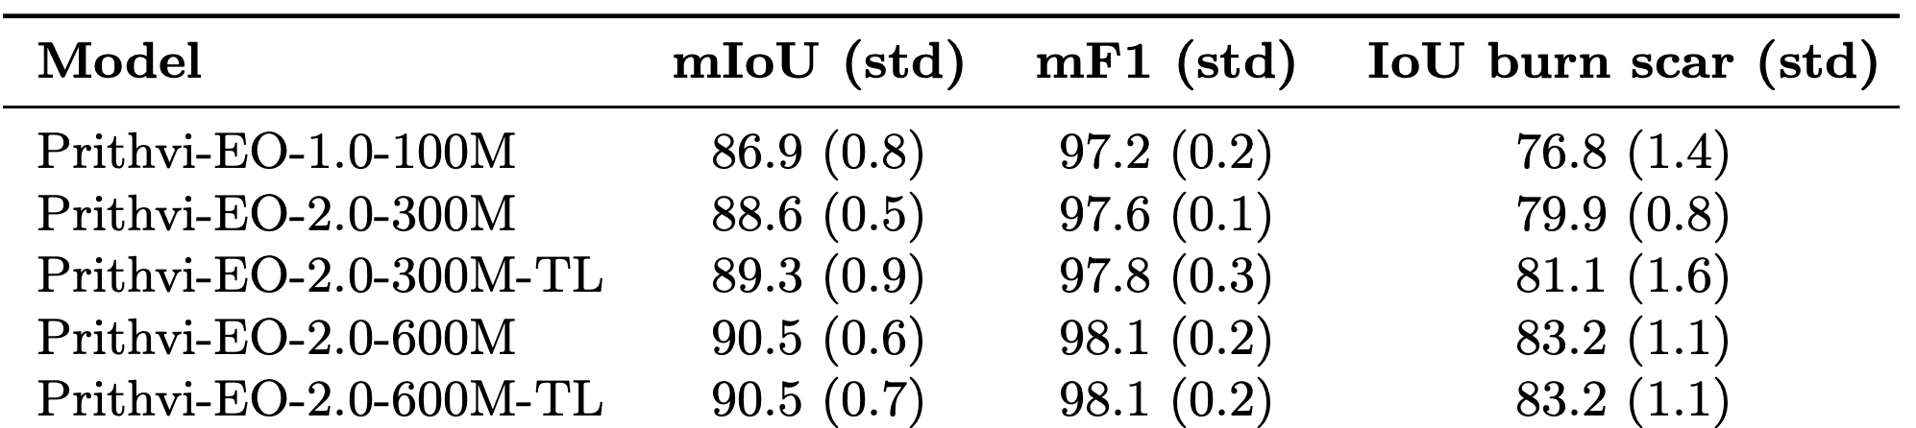
Results on the Sen1floods11 Dataset
Results on the Wildfire Scar Mapping Dataset

Slide 19
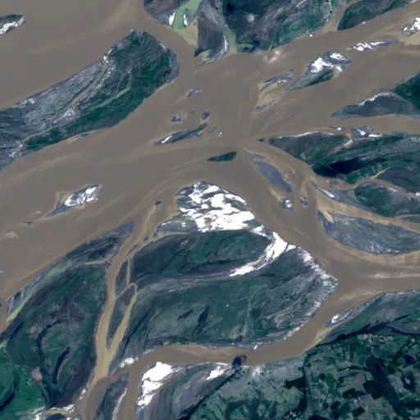
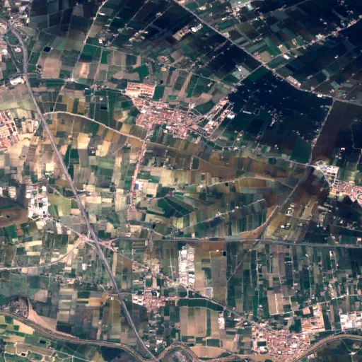
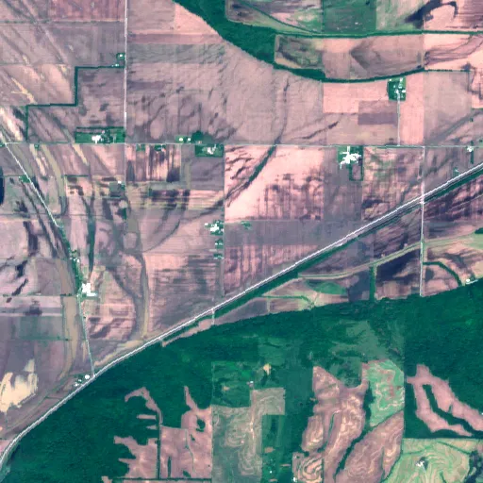

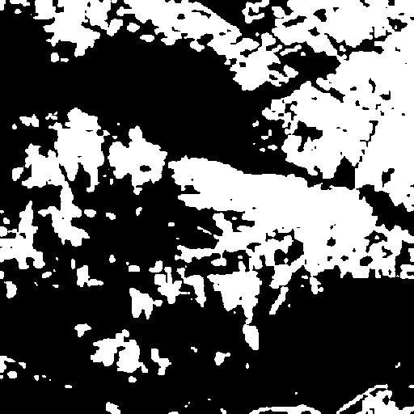

Notes:
India_900498_S2Hand.tif
Spain_7370579_S2Hand.tif
USA_430764_S2Hand.tif

Slide 20
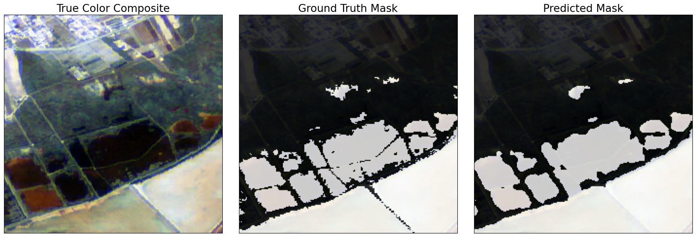
Flood Mapping

Slide 21
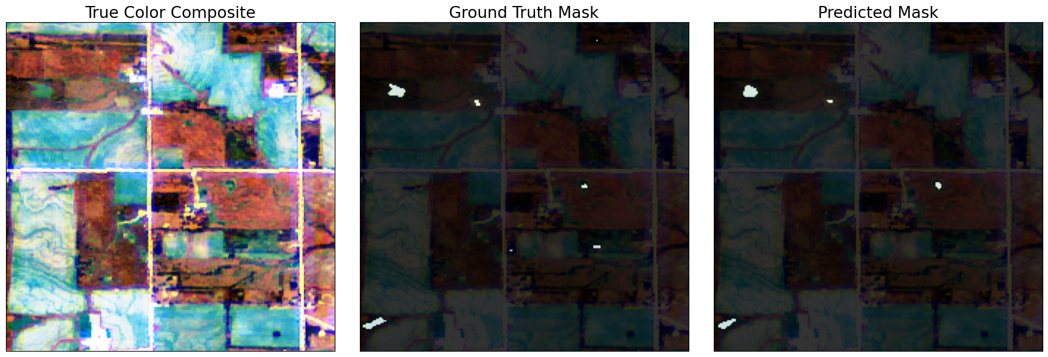
Flood Mapping

Slide 22
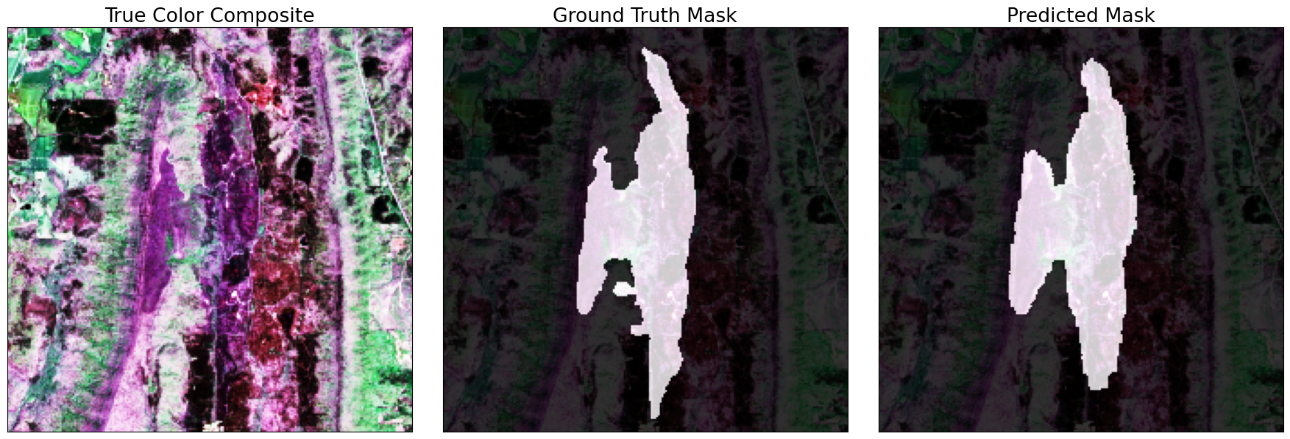
Burn Scar Mapping

Slide 23
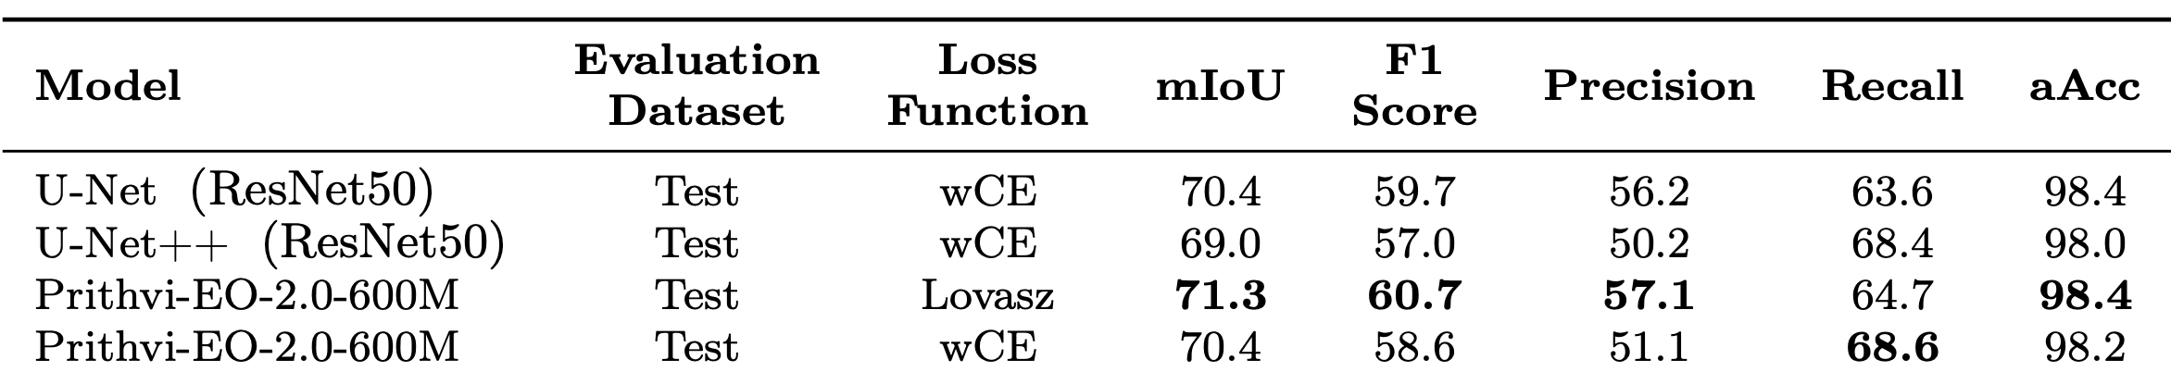
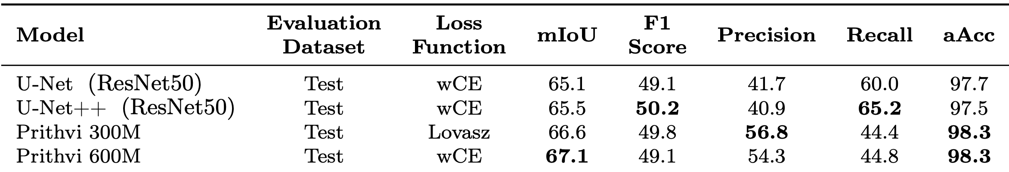
Results on the Landslide Detection Dataset
Results on the Landslide Detection Dataset (Small)

Slide 24
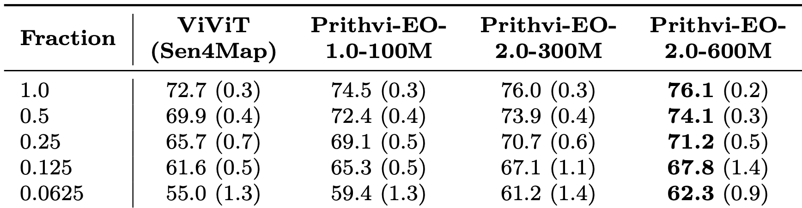
Mean F1 Score and STD for the Land Cover Classification, Fine-Tuning the Models on Fractions of the Original Dataset, Compared to Baseline ViViT

Slide 25
Finetuning with 10% Labeled Train Data
Epoch Case G_Huge G_LoRA_Huge G_Large G_LoRA_Large 100M
150 Burn 0.95 0.86 0.977 0.929 0.912
150 Flood 0.903 0.927 0.931 0.947 0.908
80 Crop 0.471 0.309 0.579 0.561 0.517
mACC
Epoch Case G_Huge G_LoRA_Huge G_Large G_LoRA_Large 100M
150 Burn 0.863 0.764 0.933 0.848 0.860
150 Flood 0.786 0.788 0.842 0.832 0.833
80 Crop 0.29 0.170 0.407 0.375 0.343
mIoU
Epoch Case G_Huge G_LoRA_Huge G_Large G_LoRA_Large 100M
150 Burn 0.923 0.857 0.964 0.915 0.922
150 Flood 0.877 0.88 0.913 0.907 0.94
80 Crop 0.443 0.285 0.564 0.533 0.496
mF1

Slide 26
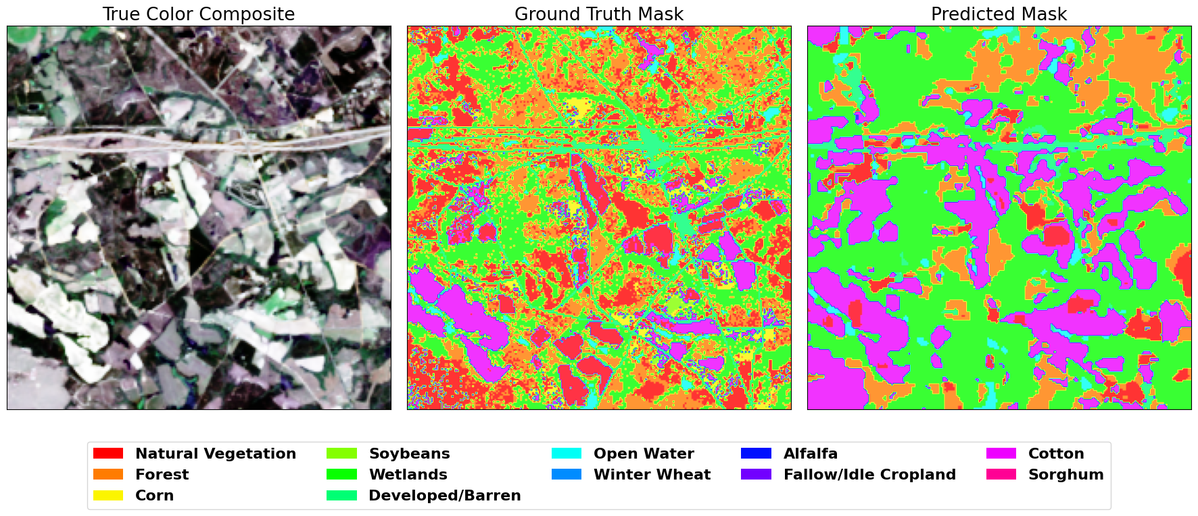
Crop Classification

Slide 27
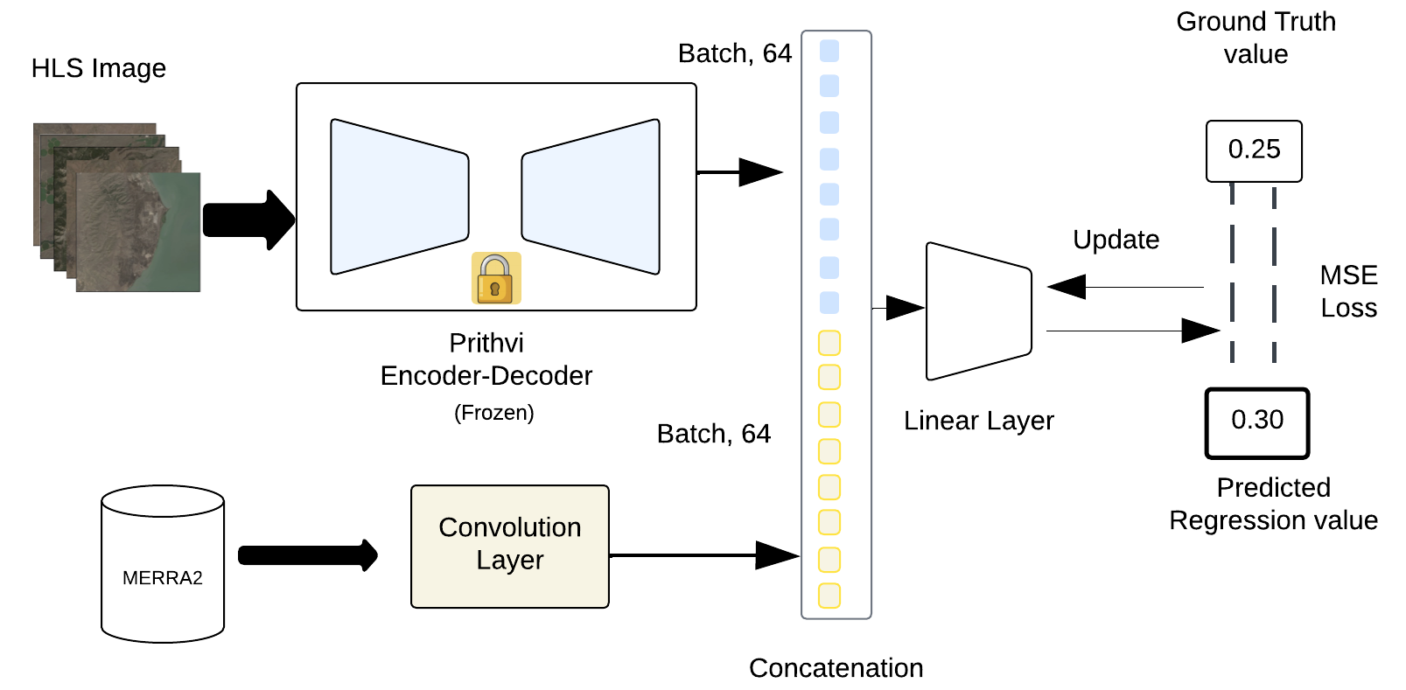
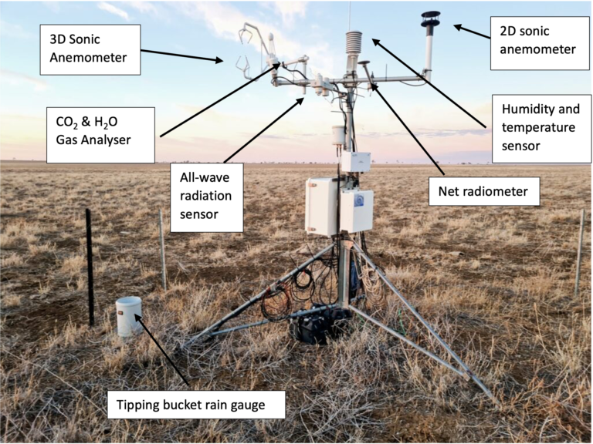
Prithvi Finetuning for GPP Flux (Regression)
Data: single timestep HLS images (30m) + MERRA2 (10 vars) centered around eddy covariance flux towers

Slide 28
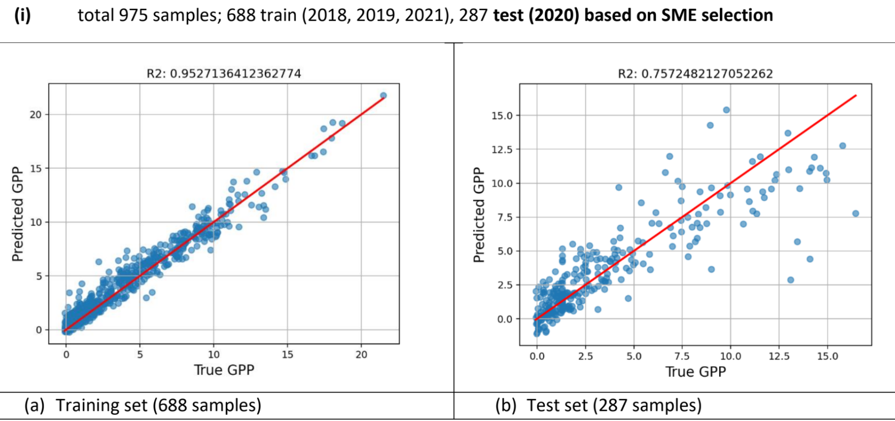
Regression Result: Predicted vs. True GPP

Slide 29
Summary
Trained geospatial FM Prithvi on global HLS v2 satellite data
Sampling strategy was based on LULC and temporal conditions (T=4)
300M parameter model with temporal and location embedding
600M parameter model with temporal and location embedding
Prithvi has been evaluated on multiple downstream tasks
Segmentation – burn scar, flood water delineation, landslide, crop classification and burn intensity
Regression: GPP flux eddy covariance
Generative: cloud gap imputation
Models trained using as low as 10% of full training data can have similar performance as models trained with full training datasets
Notes:
Trained with dynamic sensing data (T=3, up to 6 months)

Slide 30


Models and Datasets
Paper
https://huggingface.co/ibm-nasa-geospatial
https://arxiv.org/pdf/2412.02732

Slide 31









Acknowledgements

Slide 32
Questions？
sujit.roy@nasa.gov

